Slide 1

Guru Ghasidas Vishwavidyalaya, Bilaspur (C.G.)
Minor project
Brain Tumor Segmentation Using UNet
Presented By:
Guided By:
AMAR DEEP,19103305
YUVRAJ SINGH, 19103375
GOPAL PATIDAR, 19103317
Mr. NISHANT BEHAR Sir
(Assistant Professor, CSE)
Department
Computer Science & Engineering
B. Tech 3rd Year, 6th Sem

Slide 2
Contents
Introduction
Object Detection Problem
Applications of Object Detection
Methodology
Flowchart of Algorithms
Tools and Software
Results and Conclusion
Future work
References

Slide 3
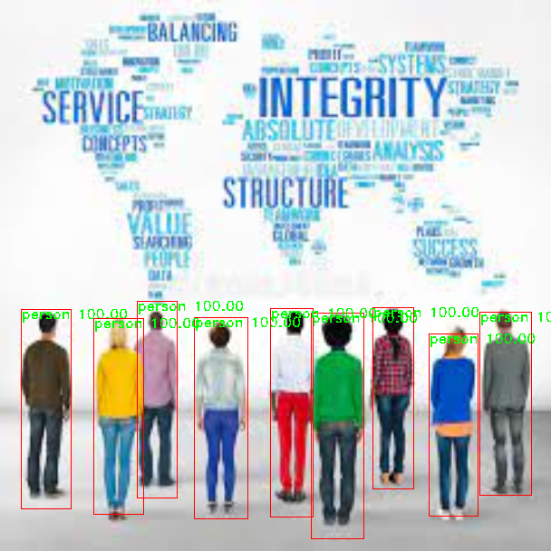
Introduction
Object Detection is a computer vision and image processing technique that deals with objects by identifying and locating them in an images or videos.
Object is an entity of interest that can be of any shape or size (i.e. person, car, bat etc.).
Object Representation shows how objects are(can be) represented on the basis of shape, motion, colour etc.
Object Localization locates the presence of an objects in an image and indicate their location with a bounding box.
Image Classification predicts the class (category) of an object.
So we can say that Object Detection is a combination of both Image Classification and Object Localization.

Slide 4
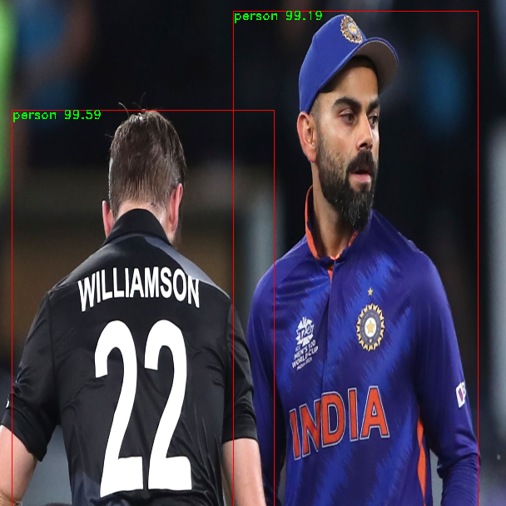
Introduction
YOLO (You only look once) is a real-time object detection algorithms described by Joseph Redmon et al in 2015.
YOLO uses Darknet as its backbone.
It uses single shot detection algorithms which means it does not use region proposal network like RCNNs, Fast-RCNNs.
SSD uses set of anchor boxes as there predetermined regions.
It may produce many bounding boxes that overlap to each other.
So, to solve this issue non-max suppression and intersection over union technique are applied.
YOLO has 5 layers, four feature extraction layer convolutional, upsample, route, shortcut and one is detection layer yolo.
Yolo also has one hyperparameter layer called net.

Slide 5
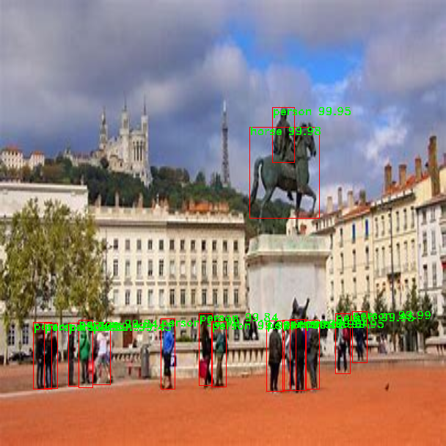
Introduction
Convolutional layer is a main building block of any object detection algorithms, which output the specific features.
Upsample layer is a layer with no weights that will increase the dimensions of input by the scale factor or stride.
Route layer does not need any further processing as it takes preceding layer as input.
[route] layer = -1 means take the results of previous 1 preceding layer as input
[route] layer=-1,-3 means take concatenation the results of previous 1 and 3 preceding layer as input
Shortcut layer is a skip connection, which help in backpropagation to skip the few layer given by from parameter
Yolo layer is a detection layer of the network

Slide 6
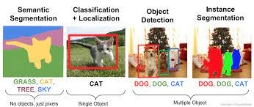
Object Detection Problem
Image classification (identifying category of the object) localization (drawing bounding boxes) together is a quite difficult task.
There are some cases in which finding the borders of the objects are required, like instance segmentation.
Source: https://towardsdatascience.com/a-hitchhikers-guide-to-object-detection-and-instance-segmentation-ac0146fe8e11

Slide 7
Applications of object detection
Face Detection
Text Detection
Logo Detection
Biometric System
Medical Imaging
Self-Driving Car
Video Surveillance

Slide 8
Methodology
Intersection over union (iou) calculates the correctness between the actual bounding box and the predicted bounding box.
predicted
actual
boxes
Union of boxes
Intersection of boxes
IoU = Area of the intersection / Area of union

Slide 9
Methodology
Non Max-Suppression select one bounding boxes out of many overlapping bounding boxes which has the highest probability.
it looks at all the other boxes in the image, which box have the high IoU with the current box are compressed.
Anchor Boxes can detect multiple object in the same image by selecting the grid which belongs to the mid-point of an object.
Anchor boxes are of different sizes and we can select more than one anchor box but of different shape than others to detect the object.

Slide 10
Methodology
Prediction:
bx = sigmoid(tx) + cx
by = sigmoid(ty) + cy
bw = pw*exp(tw)
bh = ph*exp(th)
bx, by are the x, y center coordinate and bh, bw are the width of predicted output
tx, ty, tw, th are the output of the model
ph, pw are the anchor height and width
cx and cy are the top-left co-ordinates of the grid

Slide 11
Flowchart of Algorithms
Input image
preprocessing
Processed image
model
Bounding Box Prediction
Objectness Score Prediction
Load model
Config file
Create model
Output Image
Drawing Bounding Box
Class Prediction
Flowchart of our model

Slide 12
Tools and Software
Python 3.7
Google Colab and VSCode
Py torch and some other helping library
labelImg

Slide 13
Result
Below is the table, which show the AP achieved on a single class (person).
images​ | Confidence Score of Predicted Class​ | TP / FP​ | Precisions​ | Recalls​
image1​ | 0.9998​ | TP​ | 1/1​ | 1/8​
Image2​ | 0.9992​ | TP​ | 2/2​ | 2/8​
image3​ | 0.9998​ | FP​ | 2/3​ | 2/8​
image4​ | 0.9998​ | TP​ | 3/4​ | 3/8​
image5​ | 0.9980, 0.9941​ | TP, FP​ | 4/6​ | 4/8​
image6​ | 0.9999, 0.9993, 0.1928​ | TP,FP, FP​ | 7/9​ | 7/8​
Where 8 is true bounding boxes and 9 is predicted bounding boxes
AP = 0.5503
After repeating the above procedure for all the classes (80) and iou 0.50 to 0.95 at the step of 0.5, we have achieved the mAP = 0.59. This shows our model is doing a good job, but it also failed to predict right class of low resolution images.

Slide 14
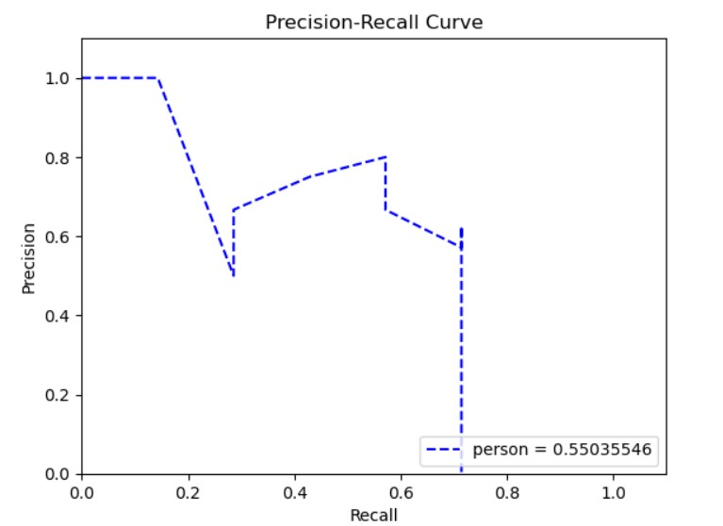
Precision-Recall Curve

Slide 15
Future Works
To add custom classes in the model
Implementing YOLOv3 on real time videos.
Try to implement YOLOv3 using some other neural network (ie. ResNets).
To compare YOLOv3 vs some other object detection algorithm like RCNN.

Slide 16
References
https://pjreddie.com/darknet/yolo/
YOLOv3: An Incremental Improvement
Generalized Intersection over Union: A Metric and A Loss for Bounding Box Regression
Learning non-maximum suppression
https://towardsdatascience.com/map-mean-average-precision-might-confuse-you-5956f1bfa9e2
https://pytorch.org/tutorials/
https://pytorch.org/tutorials/beginner/data_loading_tutorial.html
paperspaceblog
Stack overflow
geeksforgeeks

Slide 17
Thank You

